Slide 1
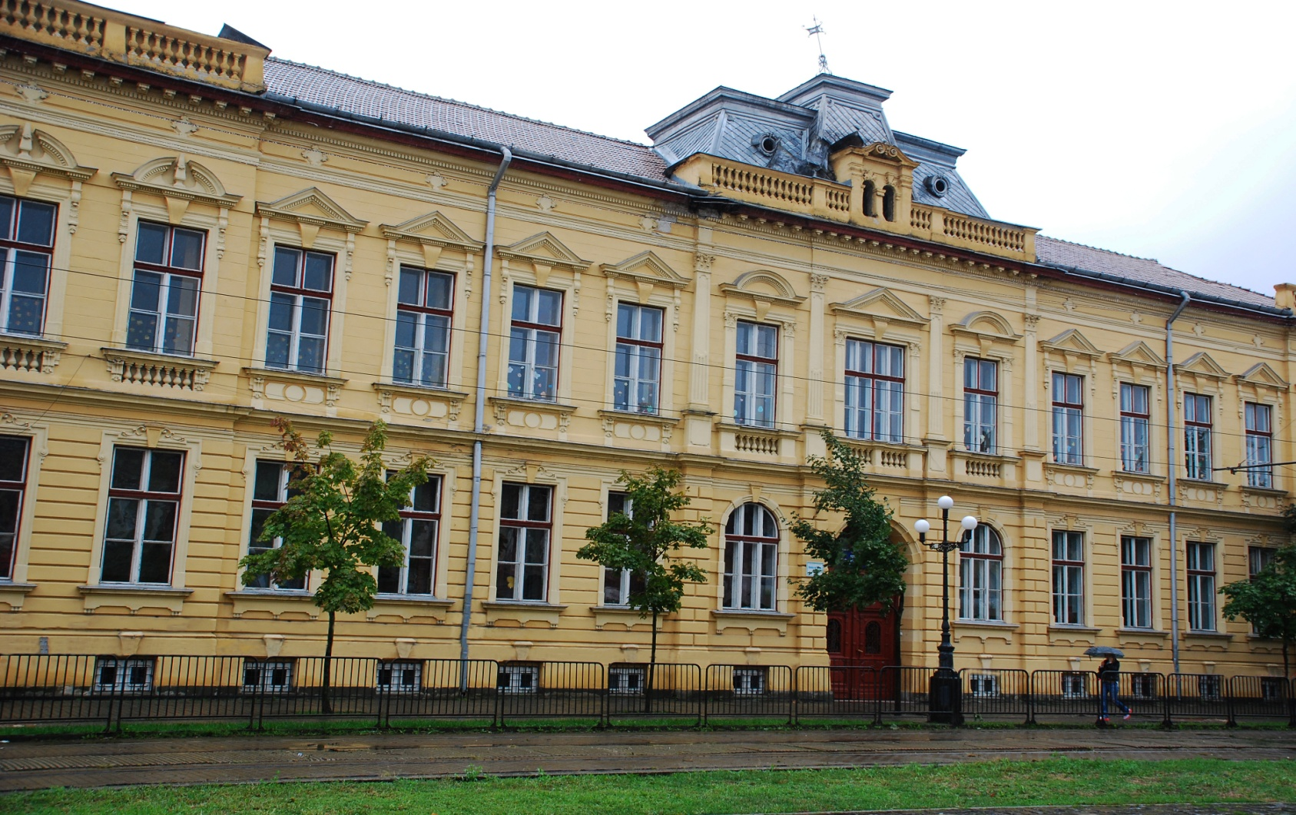
MY SCHOOL ȘCOALA GIMNAZIALĂ NR .12 TIMIȘOARA

Slide 2
TIMIȘOARA
the largest city in West of Romania;
the capital city of Timiș County;

Slide 3
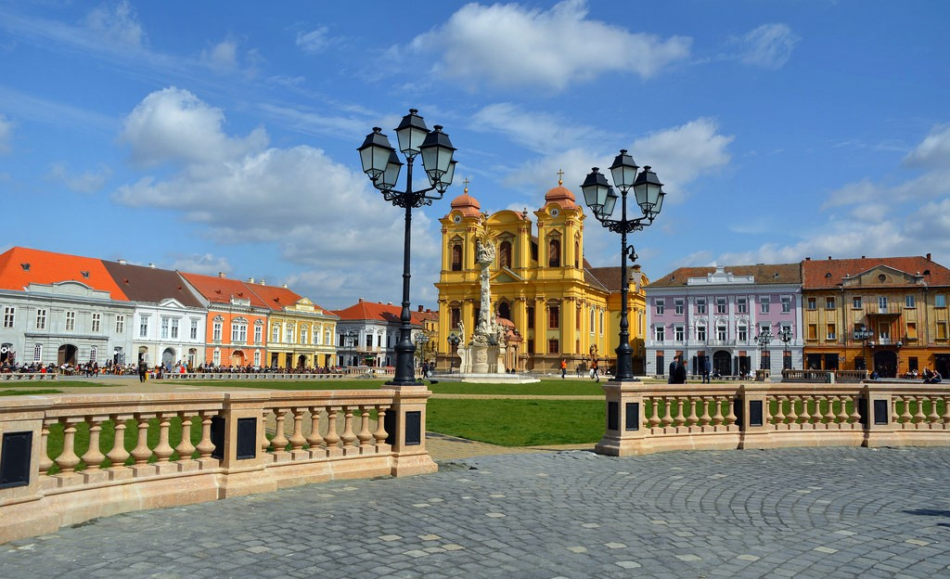
TIMIȘOARA
The Orthodox Mitropolitan Cathedral is the tallest cathedral in Romania and one of the largest churches in our country.
The Dome is the most important baroque monument in Banat.

Slide 4
ȘCOALA GIMNAZIALĂ NR .12 TIMIȘOARA
is a school with a tradition of over 200 years in education;
is located in a historical neighbourhood from Timișoara;
it is attended by 600 pupils between 3 and 15 years old;

Slide 5
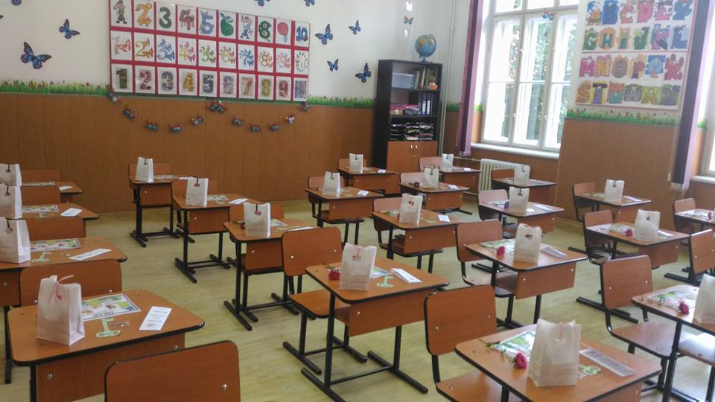
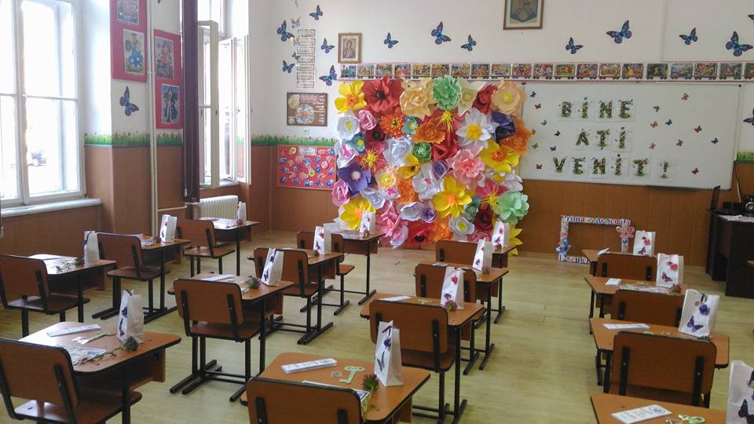
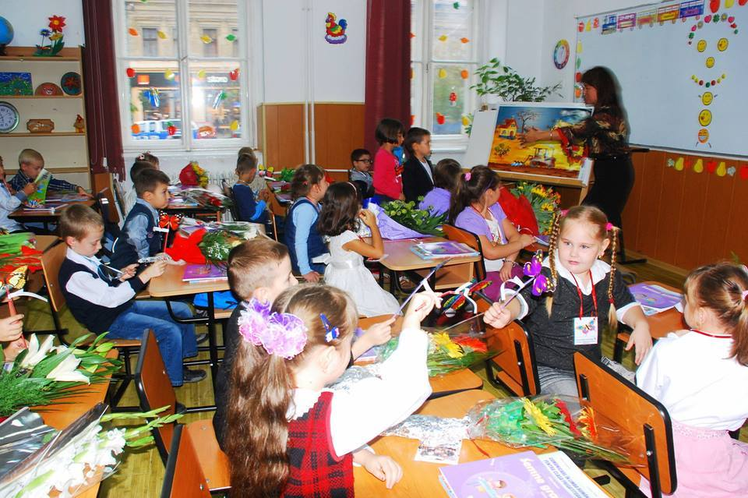
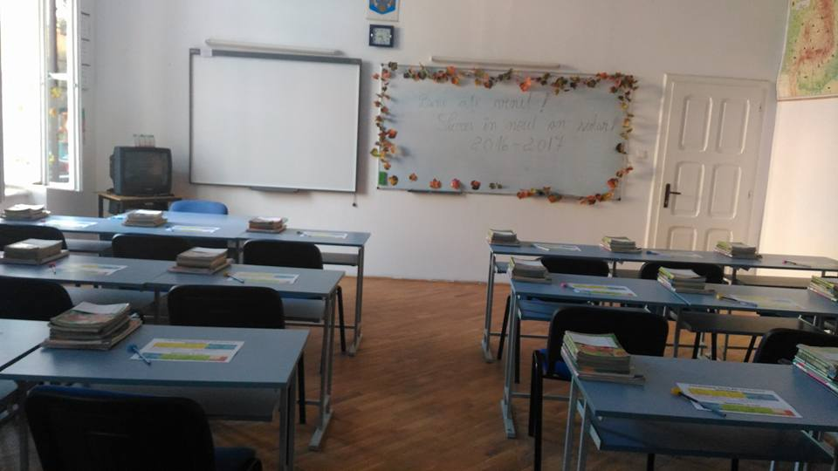
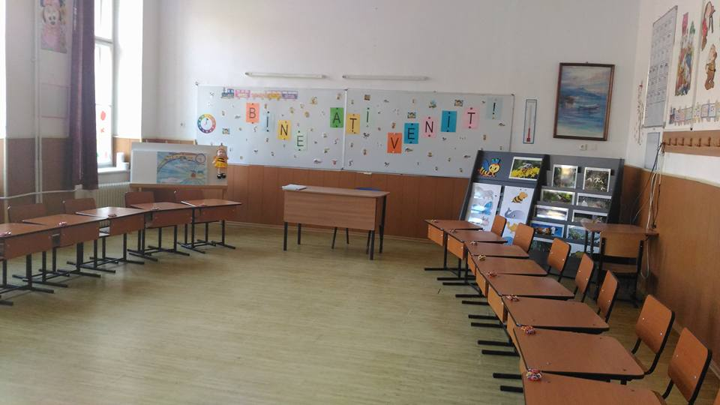
ȘCOALA GIMNAZIALĂ NR .12 TIMIȘOARA

Slide 6
ȘCOALA GIMNAZIALĂ NR .12 TIMIȘOARA
Our projects
The school is involved in national and international projects in order to offer a high quality education within the spirit of the European values.
ECO – SCHOOL S
Joy of reading (bucuria lecturii)
eTwinning projects

Slide 7
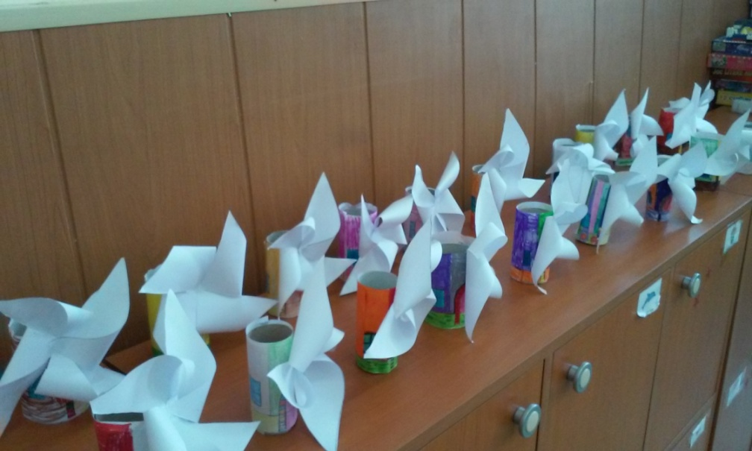
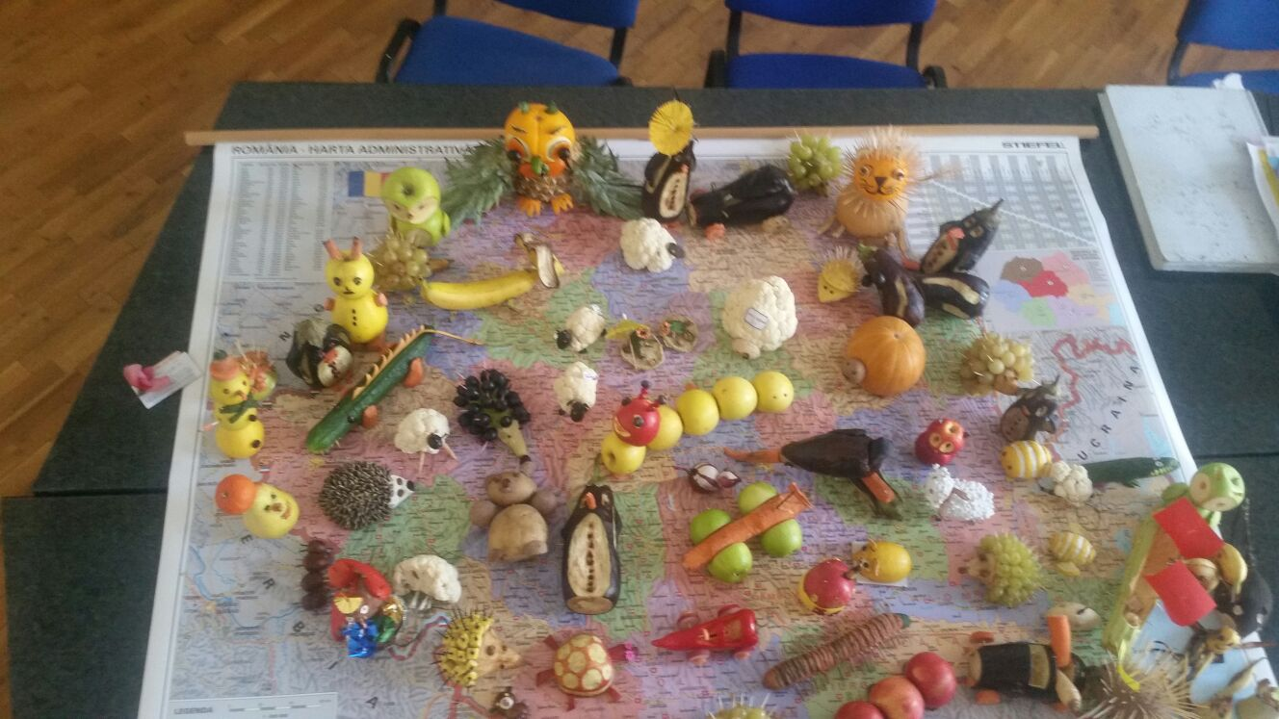
ECO – SCHOOL
It is an international project which encourages children to have an environmental attitude and cultivates a sustainable mindset which they can apply on a daily basis.

Slide 8
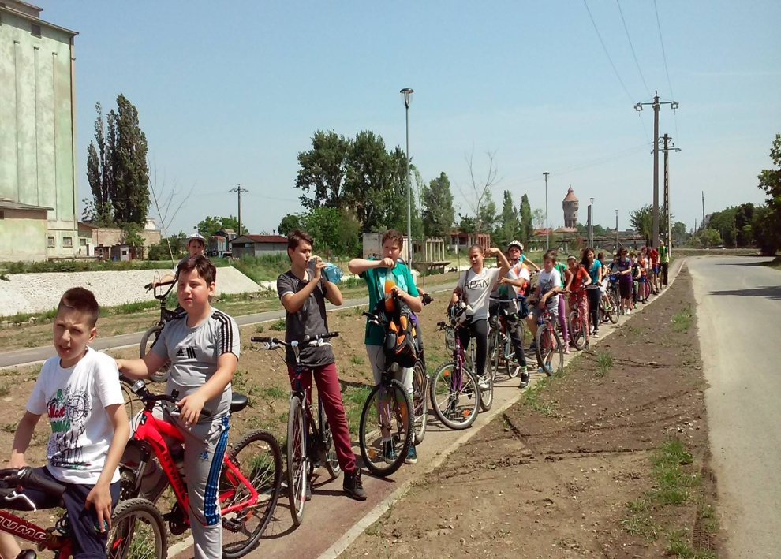
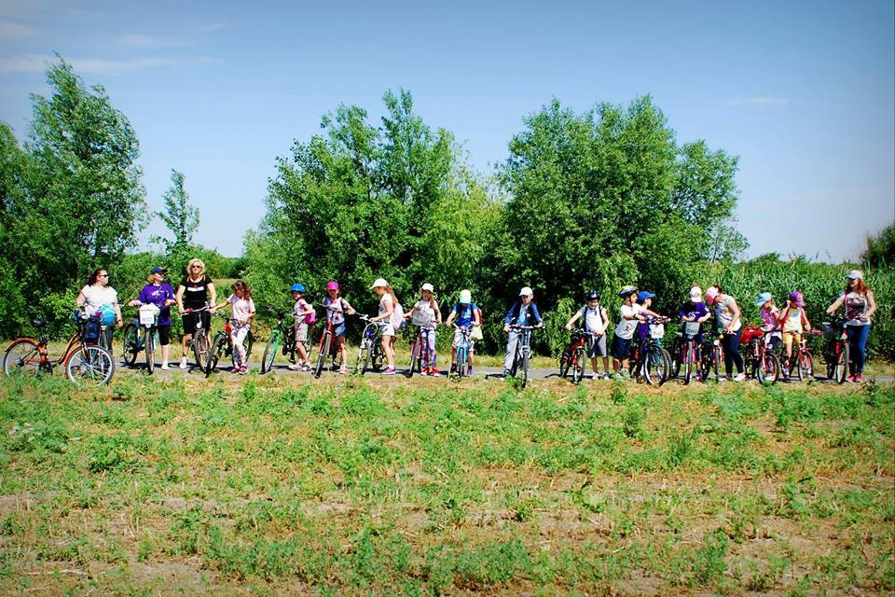
ECO – SCHOOL
another way to use energy;

Slide 9
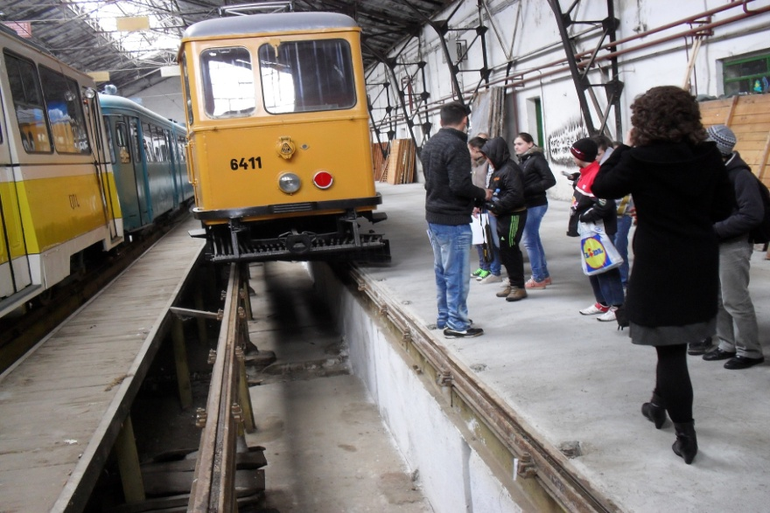
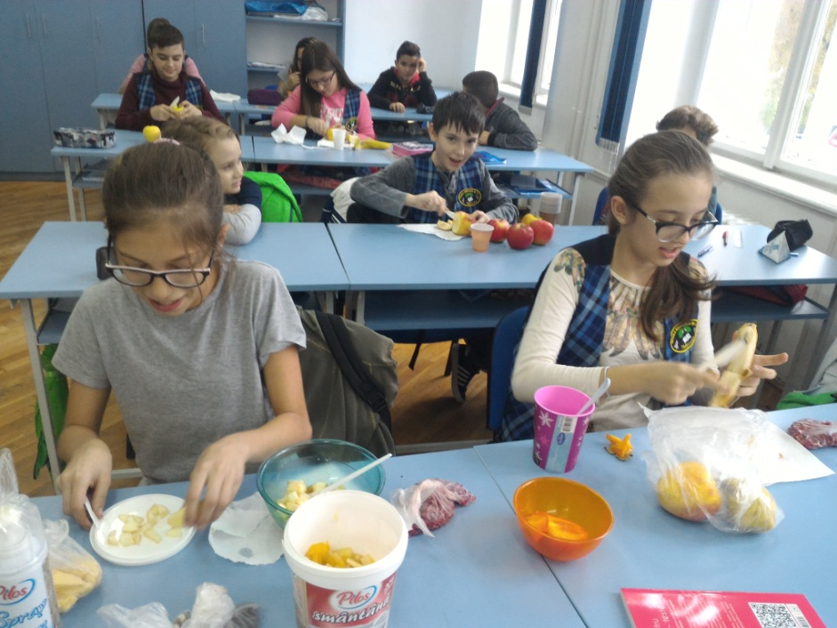
ECO – SCHOOL
means of transport
healthy life

Slide 10
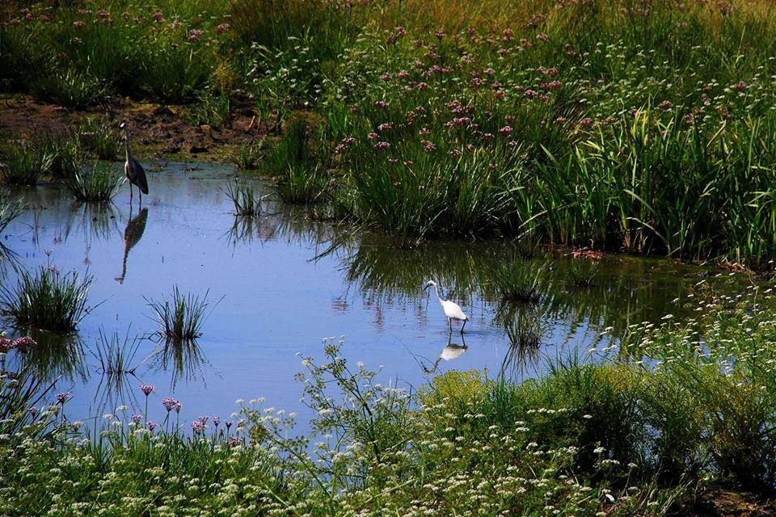
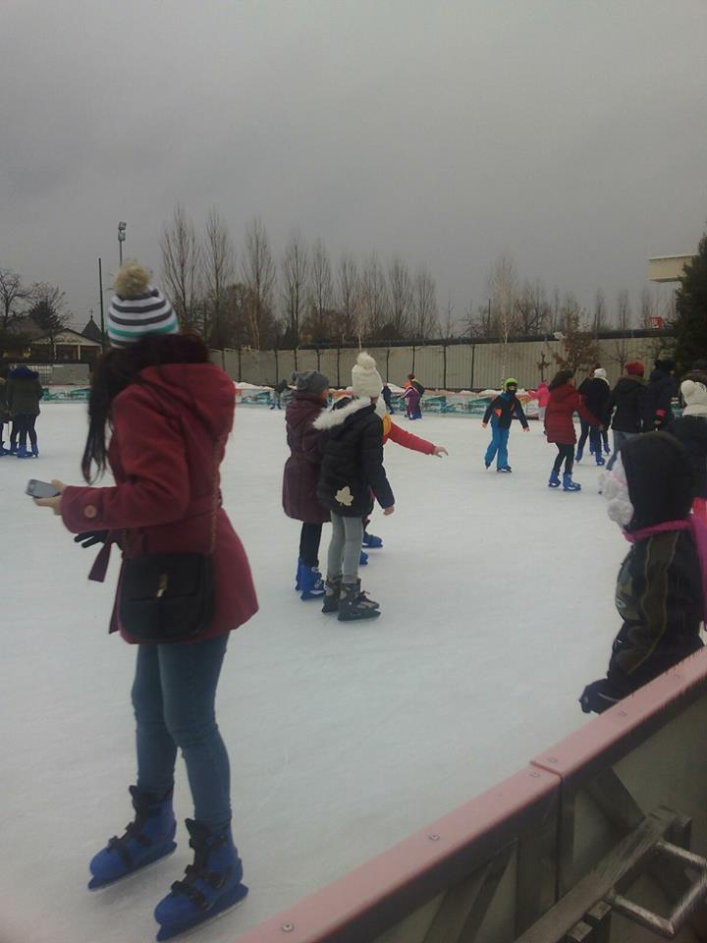
ECO – SCHOOL
the power of water

Slide 11
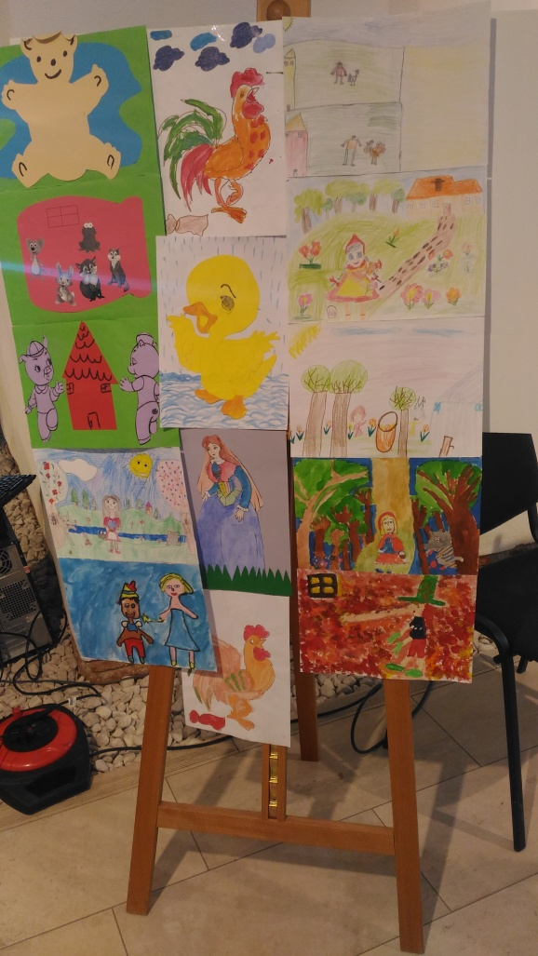
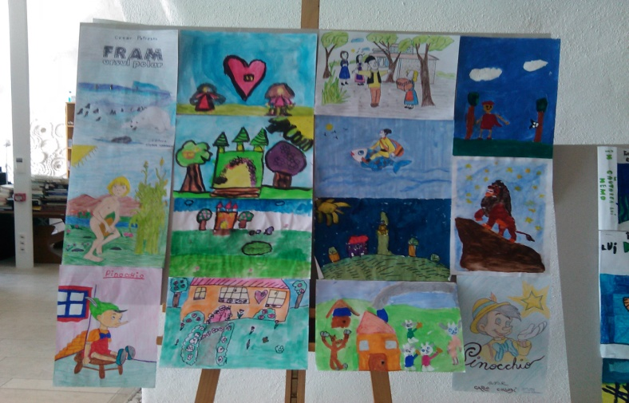
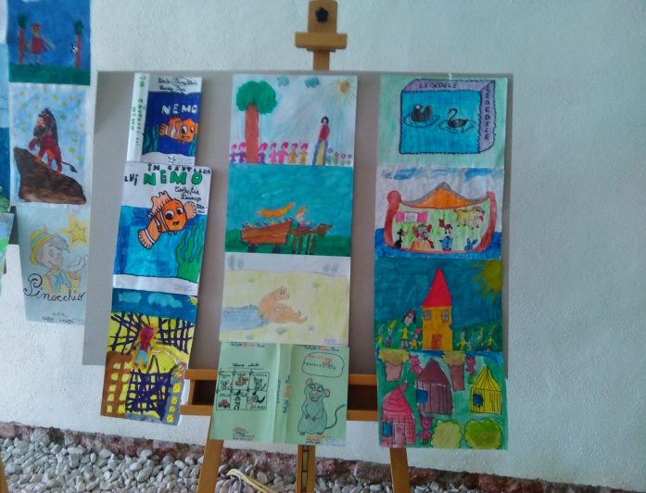
Joy of reading
The Joy of Reading is a national project. It tries to convince children and teenagers of the importance of reading.

Slide 12
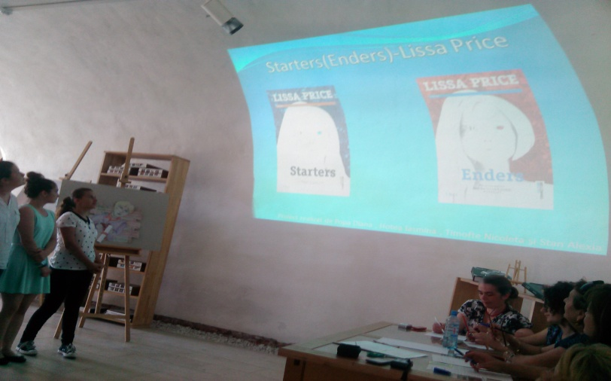
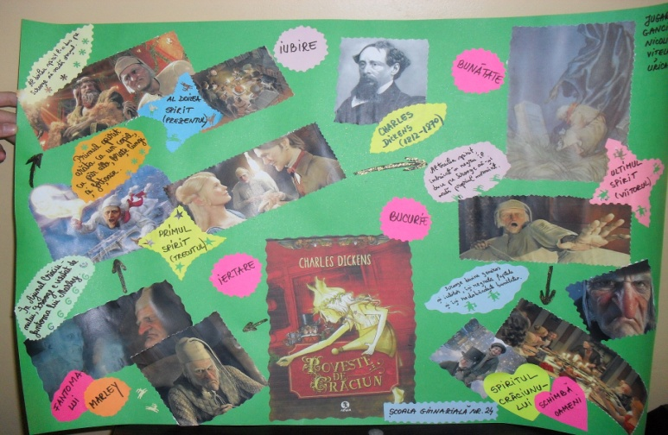
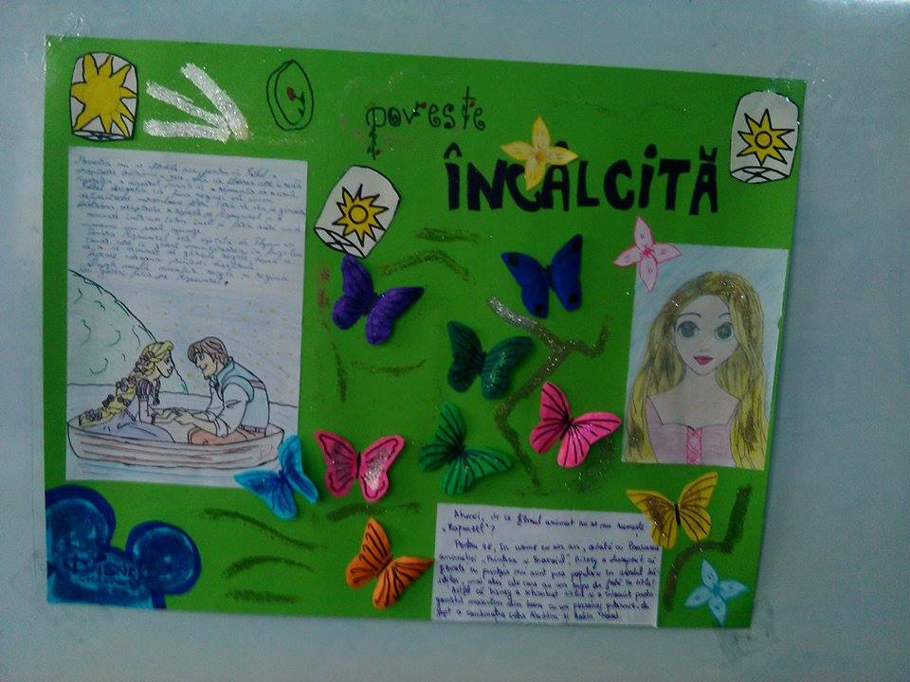
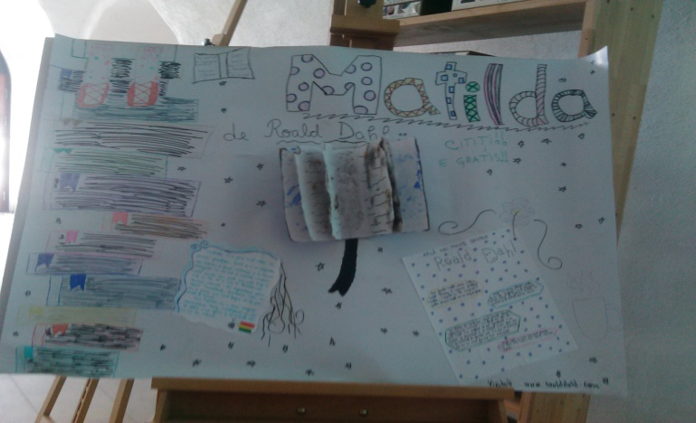
Joy of Reading
Books presentation
CREATIVITY

Slide 13
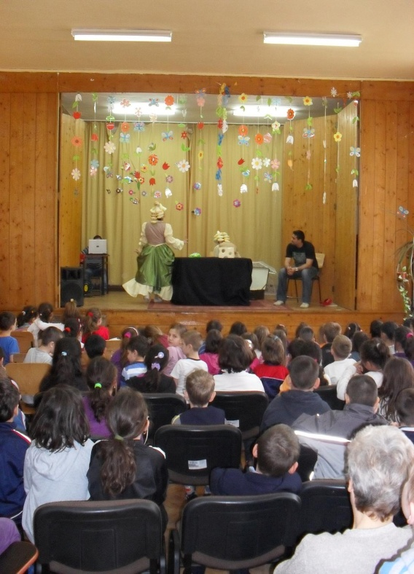
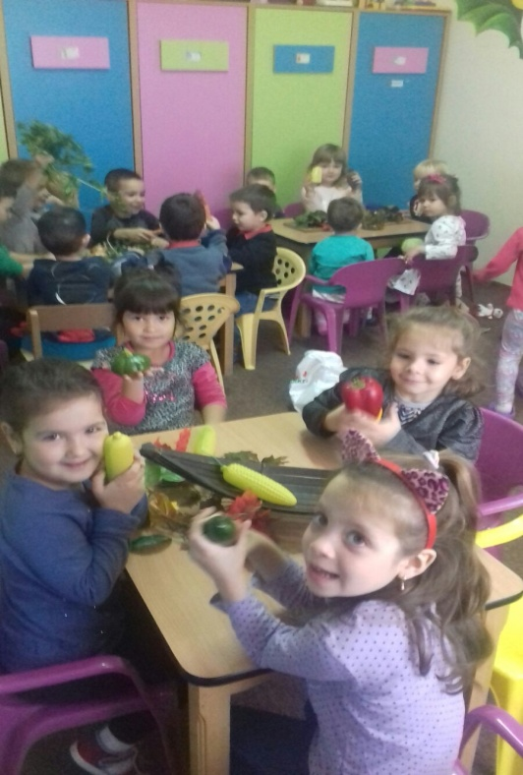
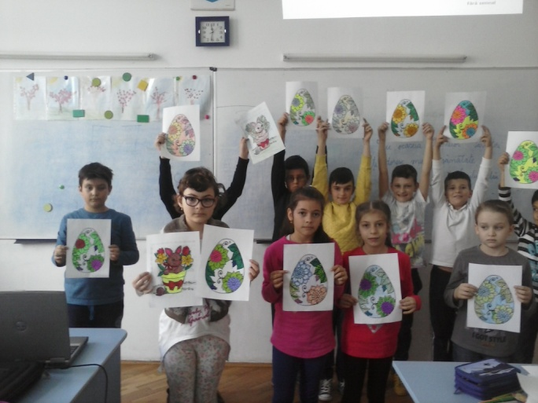
ȘCOALA GIMNAZIALĂ NR .12 TIMIȘOARA
A good education for all children!

